Slide 1

Business Analytics II (BIS 244 – Chapter 3)
BIS 244 – Fall 2022 – Dr. Davoodi

Slide 2

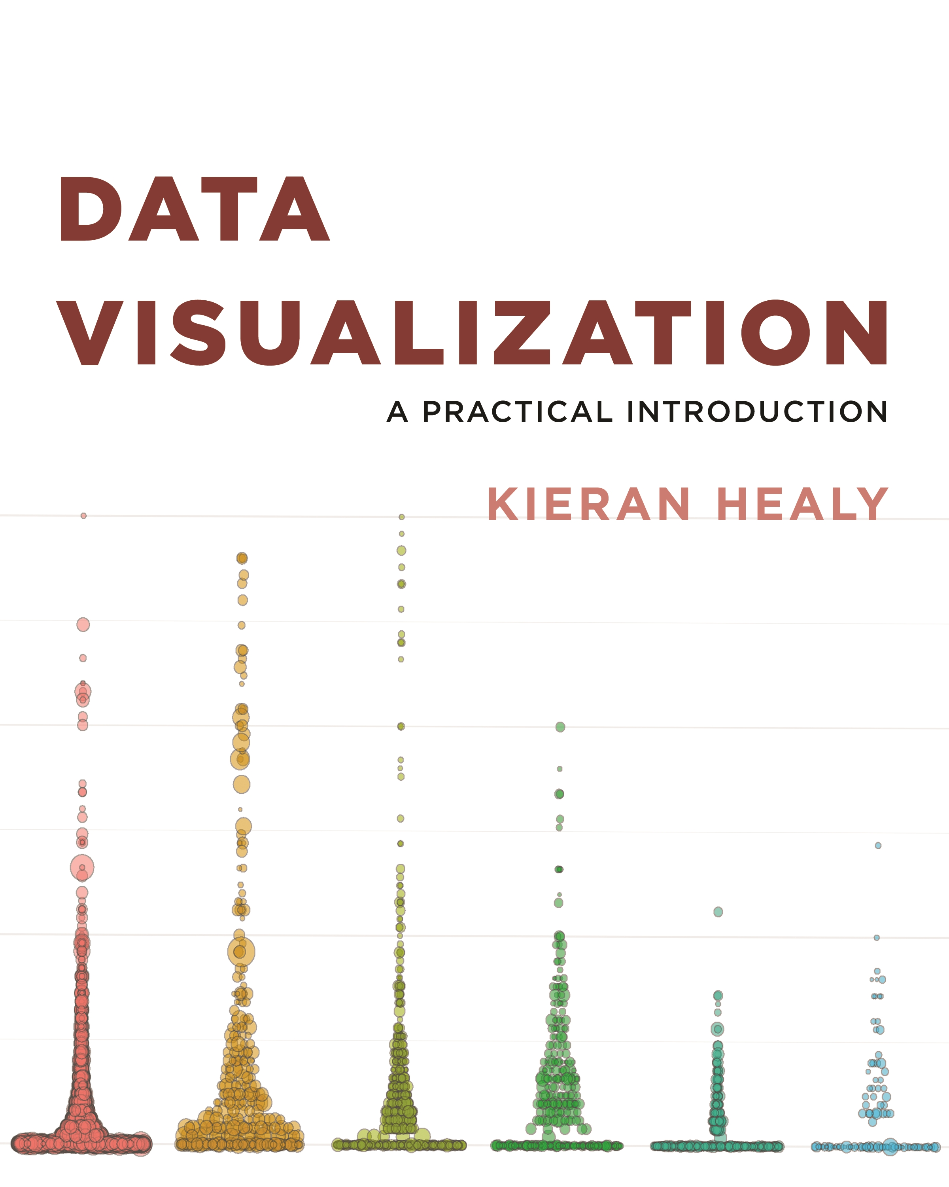
Chapter 3: Make a Plot

Slide 3
The Rest of Semester Class Schedule
Main focus: Using the ggplot2 package to start laying out some graphs in R:
Which graph is suitable for showing different types of data?
What type of graphitization would we like to see?
First step: Learn the basics of the ggplot2 package:
We need to learn ”the grammar of graphics”: Chapter 3
Chapter 3 will teach you how to use ggplot’s core functions: Introduction to the bare bone of plots

Slide 4
Chapter 3: Make a Plot
3.1 How Ggplot Works
3.2 Tidy Data
3.3 Mappings Link Data to Things You See
3.4 Build Your Plots Layer by Layer
3.5 Mapping Aesthetics vs Setting Them
3.6 Aesthetics Can Be Mapped per Geom
3.7 Save Your Work

Slide 5
3.1 How ggplot Works
As we saw in chapter 1, visualization involves representing your data using lines or shapes or colors, and so on.
ggplot provides you with a set of tools to map data to visual elements on your plot, specify the kind of plot you want, and then control the fine details of how it will be displayed.
Figure 3.1 shows a schematic outline of the process, starting from data at the top down to a finished plot at the bottom.

Slide 6
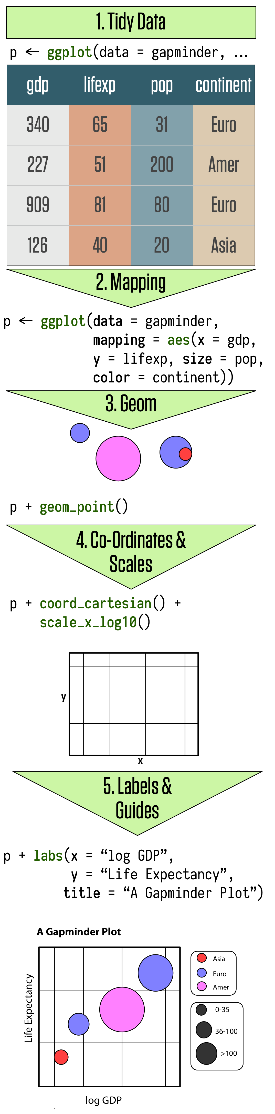
3.1 How ggplot Works
The main elements of ggplot’s grammar of graphics:
Tidy data
Mapping
Geom
Co-ordinates and scales
Labels and guides
Chapter 3 goes through these steps in detail.

Slide 7
Aesthetic Mappings (aes())
The most important thing to get used to with ggplot is how you use it to think about the logical structure of your plot.
The code you write specifies the connections between the variables in your data and the colors, points, and shapes you see on the screen.
Aesthetic mappings describe how variables in the data are mapped to visual properties (aesthetics) of geoms.
In ggplot2 , aesthetic means “something you can see”.
Construct aesthetic mappings: aes(x, y, size, color, ...)

Slide 8
3.1 How ggplot Works
You begin every plot by telling the ggplot() function what your data is and how the variables in this data logically map onto the plot’s aesthetics.
Then you take the result and say what general sort of plot you want, such as:
a scatterplot: geom_point()
a boxplot: geom_boxplot()
a bar chart: geom_bar()
In ggplot, the overall type of plot is called a geom (geometric object).
ggplot + geom will have enough information to be able to draw a plot for you.
The rest is just details about exactly what you want to see.
Notes:
In this chapter we will go through the main steps of this process.
We will proceed by example, repeatedly building a series of plots.
As noted earlier, I strongly encourage you go through this exercise manually, typing (rather than copying and pasting) the code yourself. This may seem a bit tedious, but it is by far the most effective way to get used to what is happening, and to get a feel for R’s syntax. While you’ll inevitably make some errors, you will also quickly find yourself becoming able to diagnose your own mistakes, as well as having a better grasp of the higher-level structure of plots.

Slide 9
3.2 Tidy Data
In this chapter, you will learn a consistent way to organize your data in R: An organization called tidy data.
Getting your data into this format requires some upfront work, but that work pays off in the long term.
Once you have tidy data and the tidy tools provided by packages in the tidyverse, you will spend much less time munging data from one representation to another, allowing you to spend more time on the analytic questions at hand.
library(tidyverse)

Slide 10
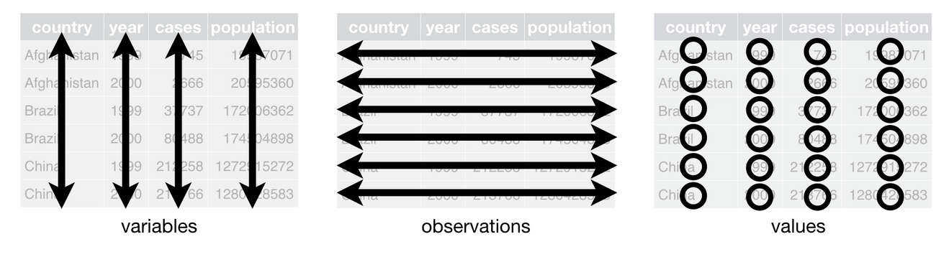
3.2 Tidy Data
You can represent the same underlying data in multiple ways: Although all representations are showing the same data, they are not equally easy to use.
There are three interrelated rules which make a dataset tidy:
(1) Each variable must have its own column.
(2) Each observation must have its own row.
(3) Each value must have its own cell.
The tidy dataset
Notes:
--Following three rules makes a dataset tidy:
variables are in columns,
observations are in rows,
values are in cells.
--These three rules are interrelated because it’s impossible to only satisfy two of the three.

Slide 11
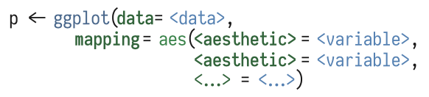
3.3 Mappings Link Data to Things You See
p <- ggplot(data, mapping, ...)
We tell the core ggplot function what our data is.

Slide 12
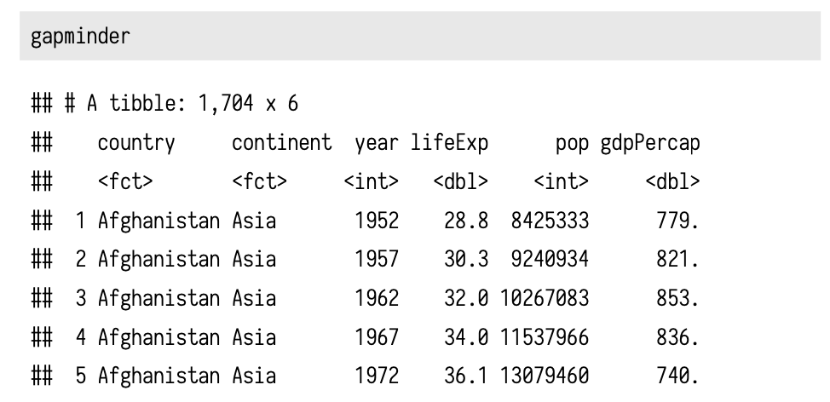
Example
We’ll use the gapminder data to make our first plots.
Make sure the library containing the data is loaded:
library(gapminder)
We can remind ourselves again what it looks like by typing the name of the object at the console:
Healy_CH3.R

Slide 13
3.4 Build Your Plots Layer by Layer
To create a data visualization using ggplot2, we’ll add up “layers” for each of the plot elements such as data points, lines, etc.
In this section, we will step through this process:
First, we will create a ggplot object (p) using the ggplot(),
Then we will add layers to it with +.
Healy_CH3.R
p <- ggplot(data)
p + geom_point() + geom_smooth() + scale_x_log10() + ...
add scatter points
add line
a log scale of x-axis

Slide 14
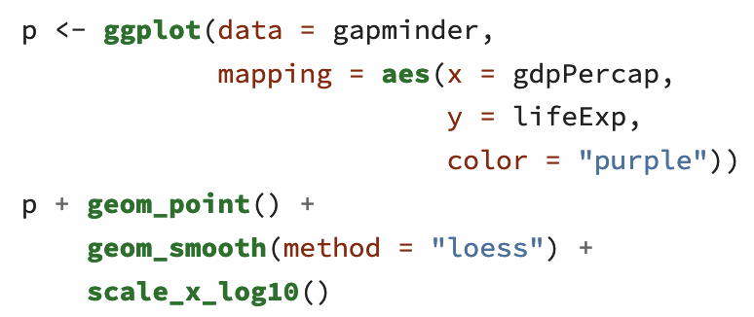
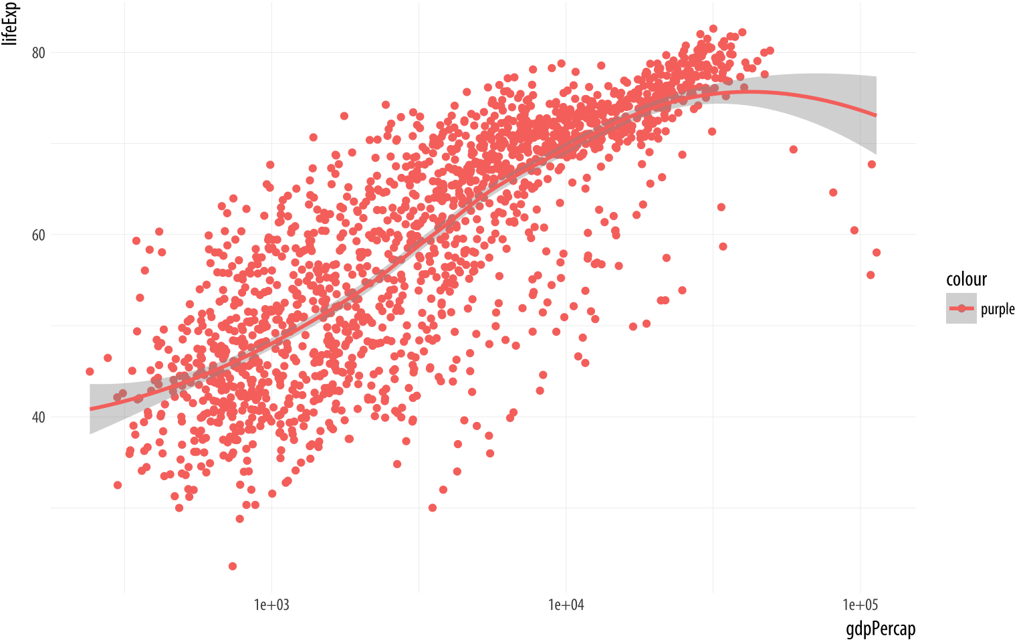
3.5 Mapping Aesthetics vs Setting Them
An “aesthetic mapping” specifies that a variable will be expressed by one of the available visual elements, such as size, or color, or shape, and so on.
This creates a new categorical variable for your data: The string “purple”
Now you have a new column. Every element in it has the same value, “purple”. Then ggplot plots the results on the graph as you’ve asked it to, by mapping it to the color aesthetic.

Slide 15
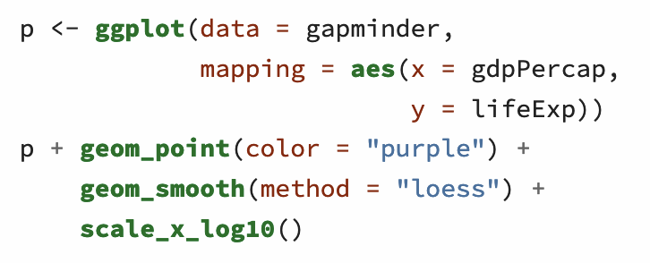
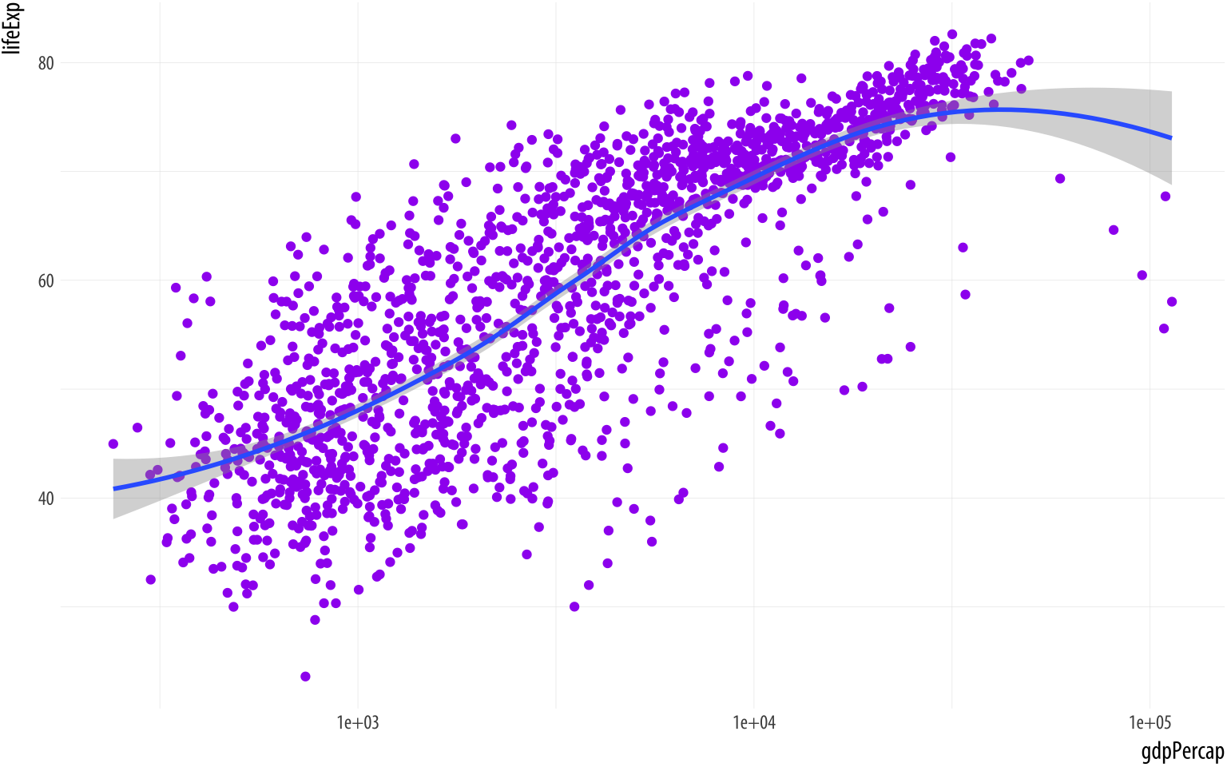
3.5 Mapping Aesthetics vs Setting Them
The aes() function is for mappings only.
Do not use it to change properties to a particular value.
If we want to set a property (or them), we do it in the geom_ we are using and outside the mapping = aes(...) step. Try this:

Slide 16
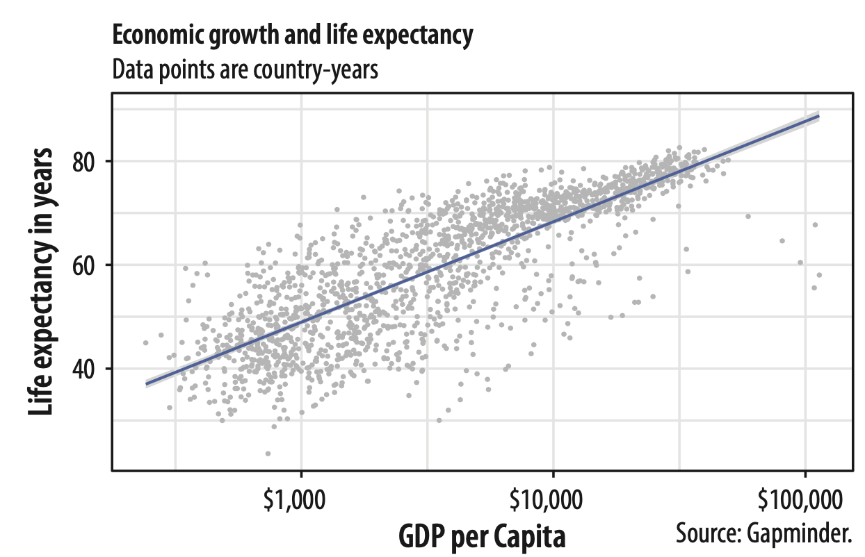
Modify Axis and Plot Labels
Good labels are critical for making your plots accessible to a wider audience.
title
subtitle
y-axis label
labs(x = "x-axis label",
y = "y-axis label",
title = "Main title of the plot",
subtitle = "Sub-title of the plot",
caption = "Add caption")
x-axis label
caption

Slide 17
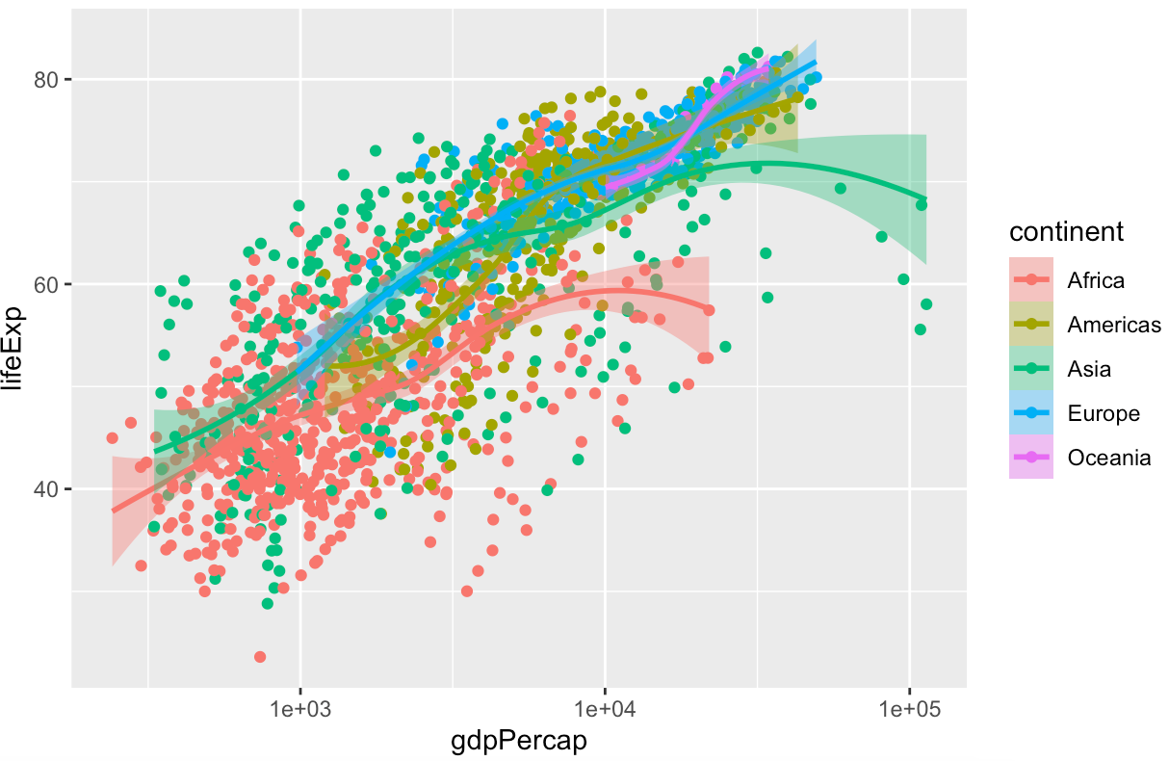
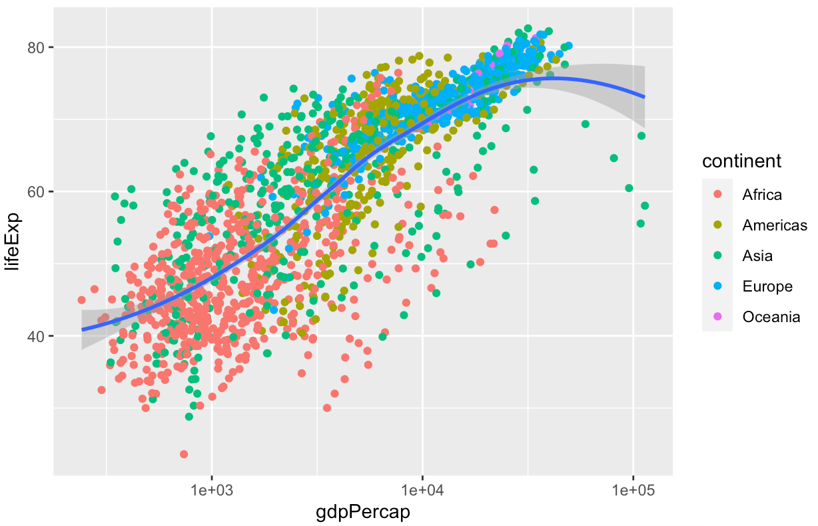
3.6 Aesthetics Can Be Mapped per Geom
Perhaps five separate smoothers is too many, and we just want one line. But we still would like to have the points color-coded by continent.
Use mapping = aes(...) expression in the geom_ functions.
Five separate smoothers
color is mapped to continent for the points
but single smoother
Notes:
By default, geoms inherit their mappings from the ggplot() function.
We can change this by mapping the aesthetics we want only the geom_ functions that we want them to apply to.
We use the same mapping = aes(...) expression as in the initial call to ggplot(), but now use it in the geom_ functions as well, specifying only the mappings we want to apply to each one. Mappings specified only in the initial ggplot() function—here, x and y—will carry through to all subsequent geoms.

Slide 18
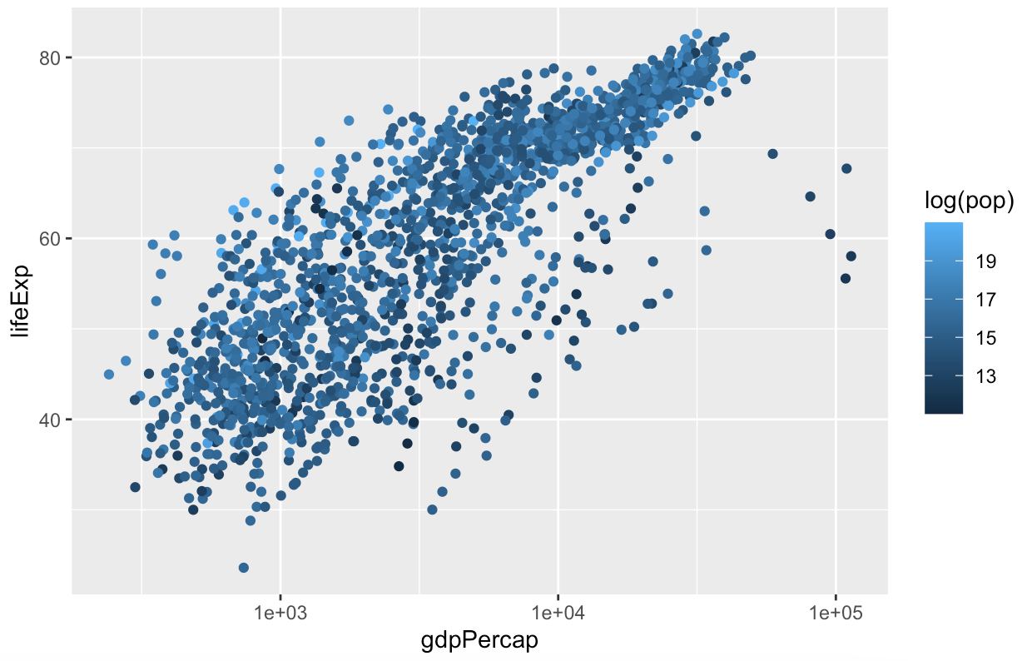
Map Continuous Variables to the Color Aesthetic
It’s possible to map continuous variables to the color aesthetic, too.
When we do this, ggplot produces a gradient scale.
It is continuous but marked at intervals in the legend.
We can map the log of each country-year’s population (pop) to color

Slide 19
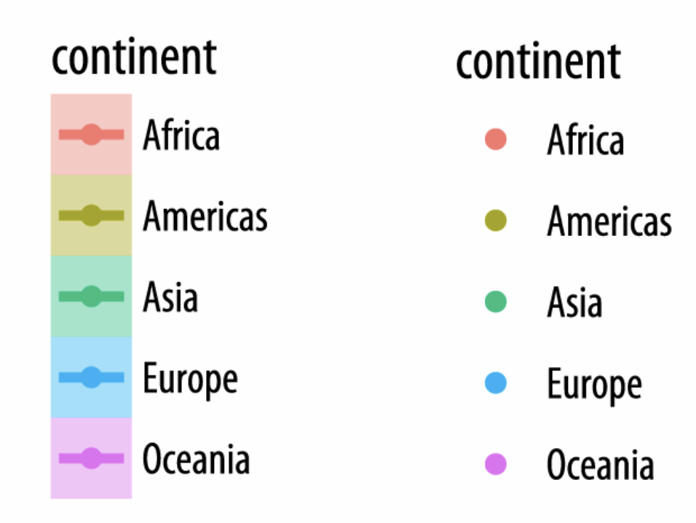
How Does ggplot Draws Its Scales?
Finally, it is worth paying a little more attention to how ggplot draws its scales.
We mapped the continent variable to both color and fill.
We then drew the figure and fitted a line for each continent.
We decided to simplify things by having only the points be colored by continent.
Mapping continuous variables to the color aesthetic (marked at intervals in the legend.)
Notes:
Because every mapped variable has a scale, we can learn a lot about how a plot has been constructed, and what mappings it contains, by seeing what the legends look like.

Slide 20
3.7 Save Your Work
Now that you have started to make your own plots, you may be wondering how to save them, and perhaps also how to control their size and format.
If you are working in an RMarkdown document then the plots you make will be embedded in it, as we have already seen.
You will often need to save your figures individually, as they will end up being dropped into slides or published in papers.
Save a figure as a PNG file: | ggsave(filename = "my_figure.png")
Save a figure as a PDF file: | ggsave(filename = "my_figure.pdf")
Save a figure as a JPEG file: | ggsave(filename = "my_figure. jpg")

Slide 21
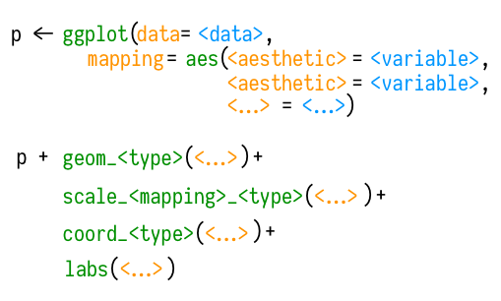
Summary
Tidy data structure for plotting
Plot data by ggplot() and assign it to an object (ex. p)
Add layers, scales, labels, etc. to the plot to develop more polished plots.
Save a plot
A schematic for making a plot.

